Slide 1
First Client Deployment
P56: Benchmark Commercial AI product for Medical Imaging Services Provider

Slide 2
Introduction
Project Goal
The project’s aim is to identify the best computer-aided detection (CAD) commercial products that will be able to diagnose TB that is on the market for our clients to use with high confidence and research to support the decision with a focus on performance and validation and usability and integration.

Slide 3
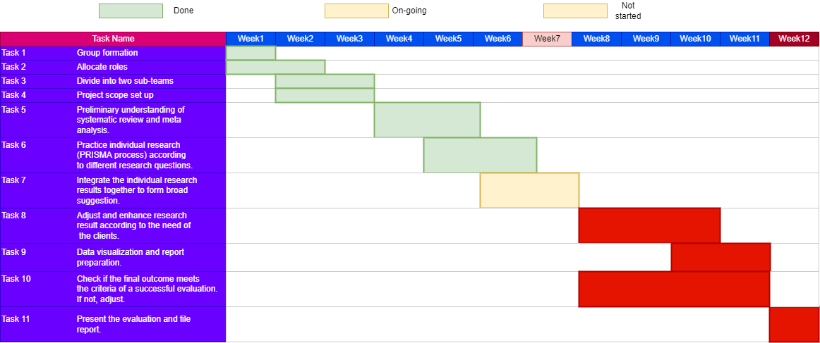
Project Pipeline

Slide 4
User Stories
As a medical imaging provider, I want a comprehensive report so that I can justify my use of qXR.
Acceptance Criteria: Report covers all topics that client has requested
Non-Functional
As a radiologist, I want to have an accurate AI product to detect TB so that I can give the correct diagnosis.
Acceptance Criteria: Most accurate AI product identified in comparison to others
Functional
4. As a radiologist, I want to ensure that qXR is the most appropriate AI tool for my needs so that I can treat my patients accordingly.
Acceptance Criteria: qXR successfully benchmarked against competitive AI tools that are certified
Functional

Slide 5
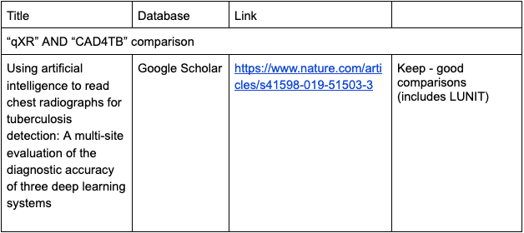
Technical Article Gathering
Initially identified 59 articles
Removed duplicates
52 Articles remain
Excluded based on title and reading
24 Articles total
Notes:
Kiran

Slide 6
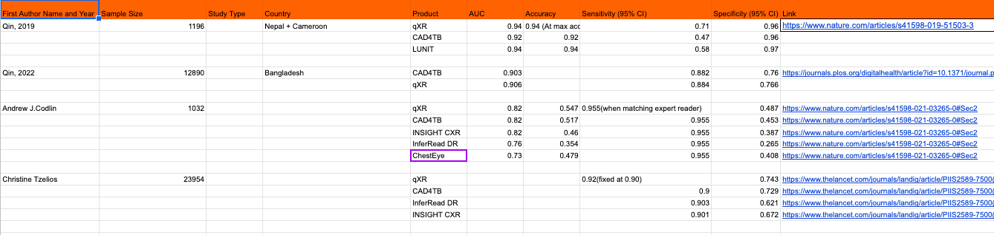
Technical Articles Summary
Notes:
Will be used to complete graphs

Slide 7
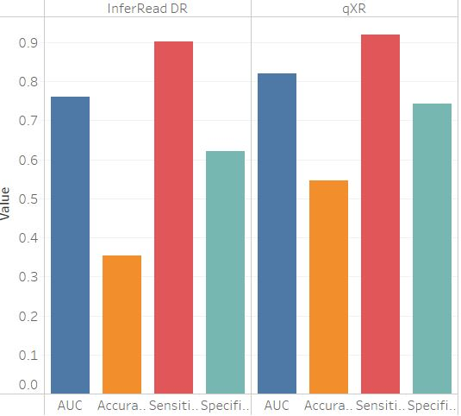
qXR vs InferRead DR

Slide 8
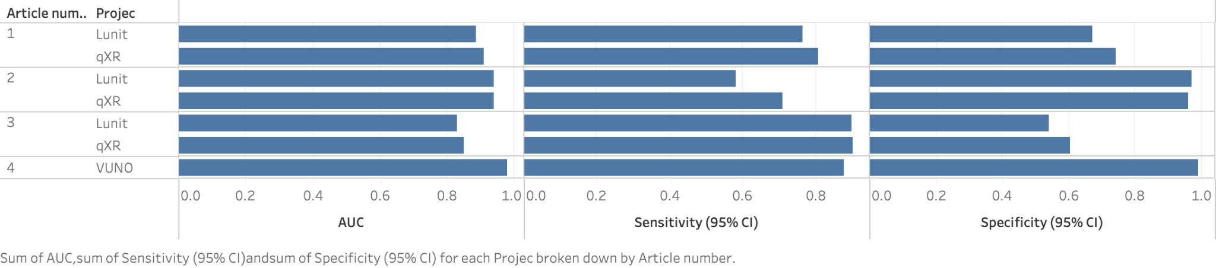
qXR vs Lunit vs VUNO
For Lunit, there are many comparative articles that support me to finish this diagram
For VUNO, I can only find very little data from the official VUNO website. Although I think that data may not be available, I still show it in the diagram.

Slide 9
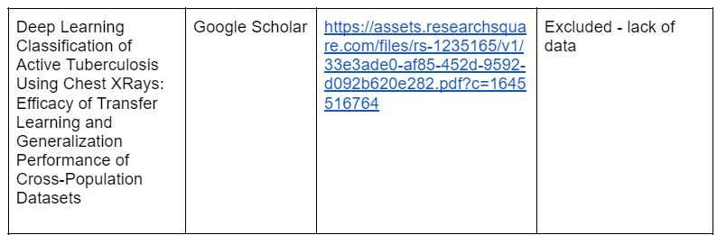
JLD-02K
Only one article found
No TB related topic
No data provided
This product hasn’t done any deep research in TB

Slide 10
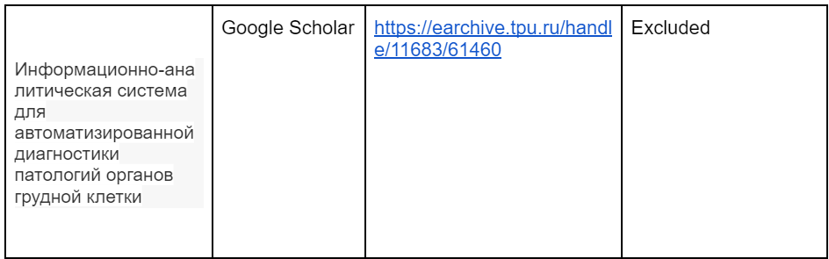
ChestEye
Only two article found
Language barrier
Lack of information
This product hasn’t done any deep research in TB

Slide 11
Excluded Products
RADIFY - Lack of analysis in online resources, likely due to being a relatively new product
JLD-02K - No TB topic related and lack of data probably because this product hasn’t done any deep research in TB
VUNO - Lack of analysis in public/third party forum, and the existed result is from VUNO official and the result is too good, so we assume it is biased.

Slide 12
Evaluating Usability and Integration of qXR
How exactly does qXR impact the workflow?
How can qXR be integrated into your clinical workflow?
What are the requirements in terms of IT infrastructure?
Notes:
Bronte

Slide 13
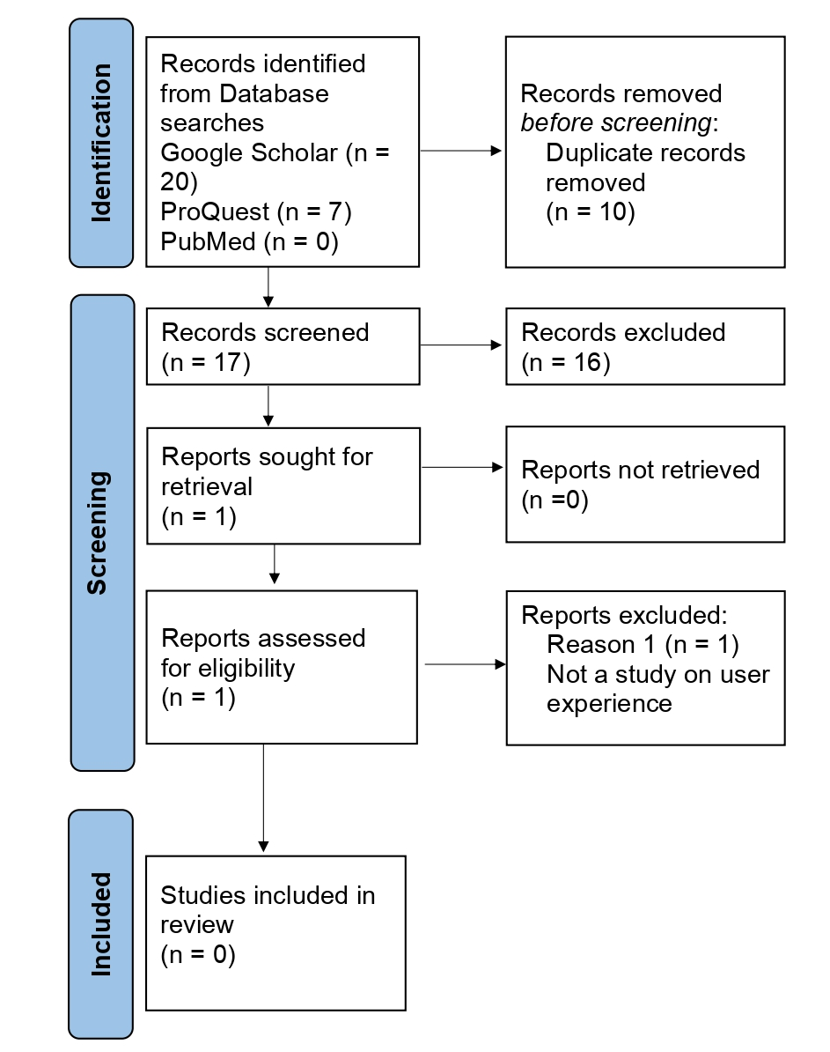
Evaluating Usability of qXR
Limitation
No user experience studies of qXR were identified
Solution
Expand evaluation to AI in radiology and apply the assumption that the evaluation will identify generic factors that could apply to qXR
Notes:
Bronte

Slide 14
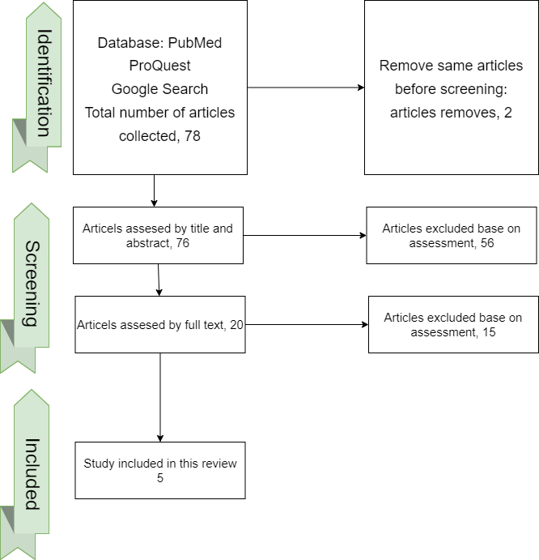
Evaluating UX for other medical imaging AI products
Purpose:
Explore the general attitude of the radiology community.
Identify the key factors users look for in product.
Gain insight on the potential future improvements.
Process:
Follow the PRISMA process.
Choose credible database.
Form multiple research questions.
Limitations:
Not many relevant articles.
Many of the studies had low number of participants.

Slide 15
Evaluating UX for other medical imaging AI products
Result:
Only 55.1% familiar with basic AI concepts.
45.9% had AI related education.
For a UX evaluation done to TRx:
Used SUS to access PEoU.
Highly rated PU and PEoU.
High output quality generally, poor output quality when diagnosing some diseases.
According to TPB (theory of planned behavior) model:
Subject norm, perceived self-efficacy, personal relevance are the factors affecting behavior intention. Behavior intention directly affects actual behavior of using AI.
According to a trust based and TAM integrated model:
Initial trust and social influence had a direct impact on behavioral intention.

Slide 16
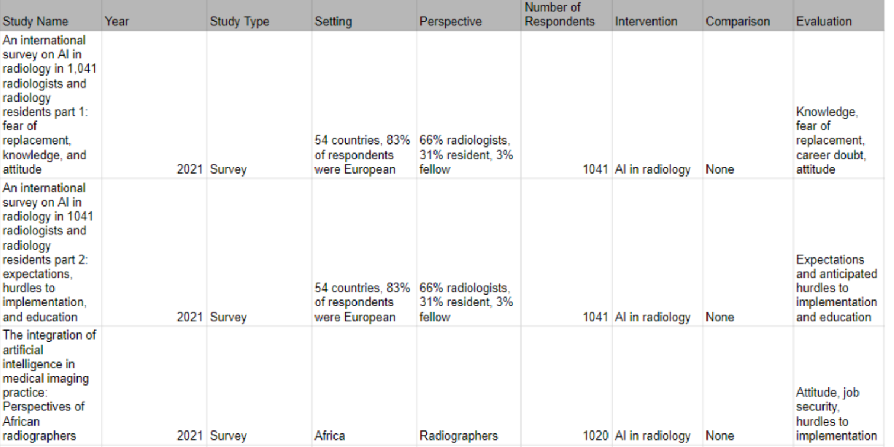
Additional Articles and Study Characteristics

Slide 17
IT Infrastructure and Integrating qXR into the Workflow
Hardware, Server, Price: N/A (waiting to hear back from partner@qure.ai)
Validation: qXR can generalize to any X-ray manufacturer (CR/DR) and has been tested with over 20 leading X-ray manufacturers globally.
Integration Modes:
API based
PACS-based
Hosting Options:
Cloud-based
API Based
Private cloud
Local IT Infrastructure
Software: Ubuntu 18.04 is preferred
Notes:
- Hardware, Server, Price: partner@qure.ai for information.
- Validation: qXR can generalize to any X-ray manufacturer (CR/DR) and has been tested with over 20 leading X-ray manufacturers globally.
- Integration: It is possible to integrate qXR with the client’s legacy PACS or directly to the X-ray device. Additionally, each deployment of qXR can be coupled with access to qTrack to facilitate viewing of results and managing the screening workflow.
o Integration Modes
§ API based
· Dicom images can be uploaded to our REST APIs through a token-based authentication. Results can be downloaded using a separate API endpoint
§ PACS based
· PACS integration based on DIMSE protocol to transfer raw scans and receive outputs. Our gateway can be added as a Dicom node in your network which will receive images, anonymize them, upload them using the APIs, download results and send these results back to your PACS.
§
o Hosting Options
§ Cloud-based
· Customers can use our cloud servers to upload scans and receive results for both modes of integration.
·
§ API Based
· Private cloud
· Local IT infrastructure
o We also offer deployment of products on local IT systems at hospitals & radiology centers.
Both grant radiologists access to a workflow management platform that supports patient registration and tracking, as well as follow-up visits and X-ray screenings scheduled for those visits. From a dashboard, admins get an overview of registered patients with the size and location of their abnormalities, plus their bacteriological test results and radiology reports.
- Software: Ubuntu 18.04 is preferred
https://qure.ai/how-we-deploy/#
https://www.ai4hlth.org/product-profiles/Qure.ai

Slide 18
Testing Plan
1 Article Quality
Search databases
Journal articles
Exclude articles connected to the creator of the product due to potential bias
2 Systematic Review Quality
PRISMA
3 Meta-Analysis Quality
2nd person to confirm data extraction
Extract data to uniform spreadsheets
Technical: Tableau for forest plots and comparisons
User experience: TAM and UTAUT model

Slide 19
Testing Plan
4 Evaluation Quality
ECLAIR
5 Report Quality
Clear and logical structure
Academic writing including complete referencing
6 Presentation Quality
Provide overview of evaluation
Professional slides with visual representations of the findings
Presenters able to answer any questions about the evaluation

Slide 20
Next Steps
Meta-Analysis
Technical
UX
Remaining ECLAIR guidelines questions
Determine recommendation
Submit final report and present presentation

